Slide 1

Project Phase II Presentation Brain Tumour Detection System Presented by Ishan Modi (B150953039) Ishan Srivastava (B150953023) Janhavi Panambor (B150953045) Guided by DR. VARSHA DEGAONKAR
Dept. of Electronics and Telecommunication
Hope Foundation’s
International Institute of Information Technology Hinjawadi Pune

Slide 2
Outline
Introduction
Literature survey
Problem statement and Objectives
Proposed Methodology
Requirement analysis
Impact analysis
Professional Ethical practices to be followed
Results
Conclusion and Future Scope
References

Slide 3
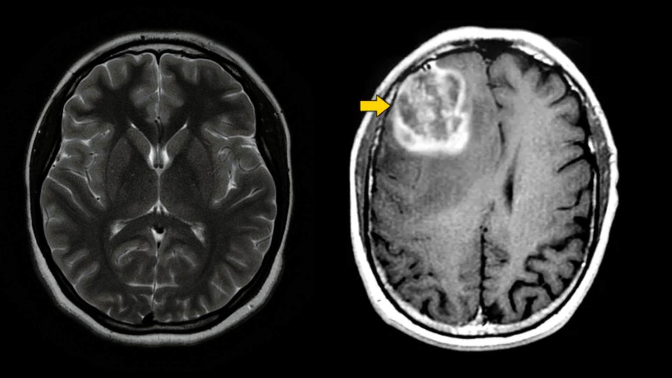
Introduction
The smart detection system operates on the AI algorithm.
It is based on feature extraction.
Early Detection of ‘Brain Tumor’.
Reduction of cost
Fig 1.- MRI Scan (researchgate.com)

Slide 4
Literature survey
Research paper title | Method | What paper suggests?
[1]Brain Tumor Detection Using Deep Learning | Convolutional Neural Network | Brain Tumor detection using CNN models with respect to the Training Dataset.
[2]Image Processing Techniques for Brain Tumor Identification | Image Processing | Suggests various methods to identify the Brain Tumor including it’s consequences.
[3]Brain Tumor Detection and Classification on MR Images by a Deep Wavelet Auto-Encoder Model | Deep Wavelet Model | Tumor detection using, Deep Wavelet Auto-Encoder Model with a different approach.

Slide 5
Literature survey
Research paper title | Method | What paper suggests?
[4]Brain Tumor Detection using Image Processing | Image Processing | Tumor is detected using Image processing.
[5]Brain tumor segmentation based on deep learning and an attention mechanism using MRI multi‑modalities brain images | Image Segmentation | A difference In the Brain cells is detected using Deep Learning and region detection (The affected part).

Slide 6
Literature survey
Research paper title | Method | What paper suggests?
[6]Pathways from symptoms to medical care: a descriptive study of symptom development and obstacles to early diagnosis in brain tumour patients | NA | Insights into various symptoms, causes and statistics of brain tumour is identified from [6] and [7]. This data is to be used into the actual web application.
[7]Brain tumours: incidence, survival, and aetiology | NA
[8]Brain Tumor Analysis Empowered with Deep Learning: A Review, Taxonomy, and Future Challenges | NA | Survey on major deep learning systems that have been implemented to do various types of brain tumour analysis can be inferred.

Slide 7
Literature survey
Research paper title | Method | What paper suggests?
[9]An improved implementation of brain tumor detection using segmentation based on hierarchical self organizing map. | Hierarchical Self Organizing Map(SOM) | Brain Tumour Detection is done using image segmentation as base technique. A clustering based approach SOM is used.
[10]Manifold Learning in MR spectroscopy using nonlinear dimensionality reduction and unsupervised clustering. | Clustering | Comparision between nonlinearity reduction and linear method is done.
[11]Investigating Brain Tumor Segmentation and Detection Techniques. | Image Segmentation | A survey on different segmentation techniques is given. Various methods can be inferred in depth.

Slide 8
Problem statement and Objectives
Problem statement
To detect brain tumor using Deep Learning algorithms and implement the same into a web application that will act as an end product. The system being developed aims to facilitate early detection of tumour so as to reduce mortality rates.
Objectives
To reduce human intervention using automation of tumour detection.
To increase awareness about the “Brain Tumor”, by providing information modules on the web application.
Reduction of medical cost by early detection and diagnosis.

Slide 9
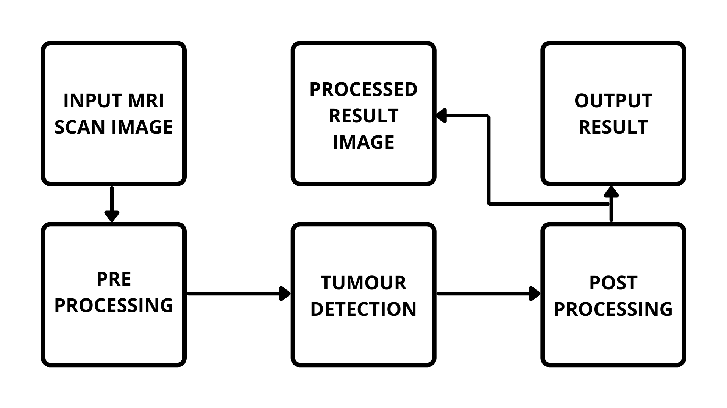
Proposed Methodology
Fig 2.- Proposed Block Diagram

Slide 10
Proposed Requirement analysis
Software Requirement
OS Requirement
Windows 8/10
Linux
Training of the model
Python IDE (Kaggle Notebook Editor)
Dataset for Training
Web Application

Slide 11
Proposed Requirement analysis
Hardware Requirement Basic Hardware for Training Purpose
RAM : 8 GB
ROM : 2 GB
Processor : i5 Processor
Limitations:
Limited detection due to less datasets being used in training.
Accuracy of Dataset is an important factor. Unverified datasets can lead to false results.
The detection model in it’s base form cannot provide accurate results on MRI captured using higher tesla MRI Machines.

Slide 12
Impact analysis
On Society
Positive Impact
Early detection may reduce Human Mortality Rate.
The system is affordable and easy to handle.
Negative Impact
It has a risk of errors and unplanned detection of false results.
It has a risk of undetected Initial stages due to small size.

Slide 13
Impact analysis
On Environment
Positive Impact
Less Bio Medical waste is generated due to early detection and treatment.
Negative Impact
Bio Medical waste generated during treatment after the detection of tumor is done through this system, if not treated properly can pose environmental risks.

Slide 14
Professional Ethical practices to be followed
Giving credits.
Keeping technical guidelines in mind.
Following the norms of engineering Practices.
Liability for outcome caused by one’s actions or decisions.

Slide 15
Results
 | Data Label | No. of Images
Test Set | Glioma | 100
 | Meningioma | 115
 | No Tumour | 105
 | Pituitary | 74
Train Set | Glioma | 826
 | Meningioma | 822
 | No Tumour | 395
 | Pituitary | 827
Table 4. - Dataset Information

Slide 16
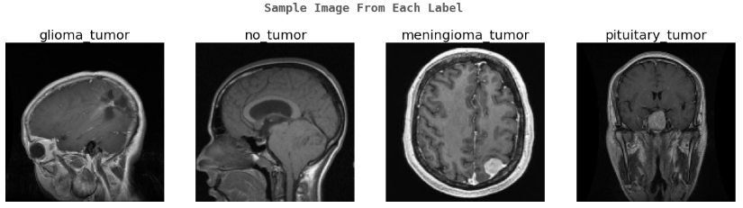
Results
Fig 3.- Sample Image from each label from the dataset.

Slide 17
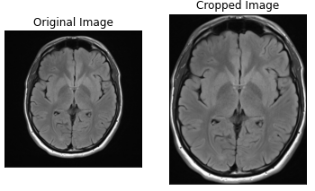
Results
Fig 4.- Results of processing of the image

Slide 18
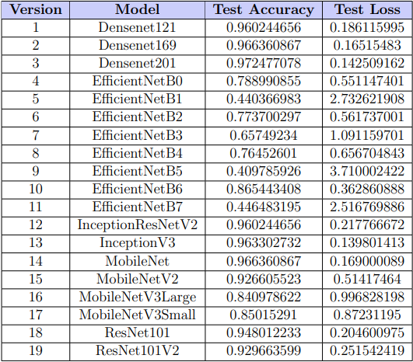
Results
Fig 5.- Loss and Accuracy Table of different trained versions

Slide 19
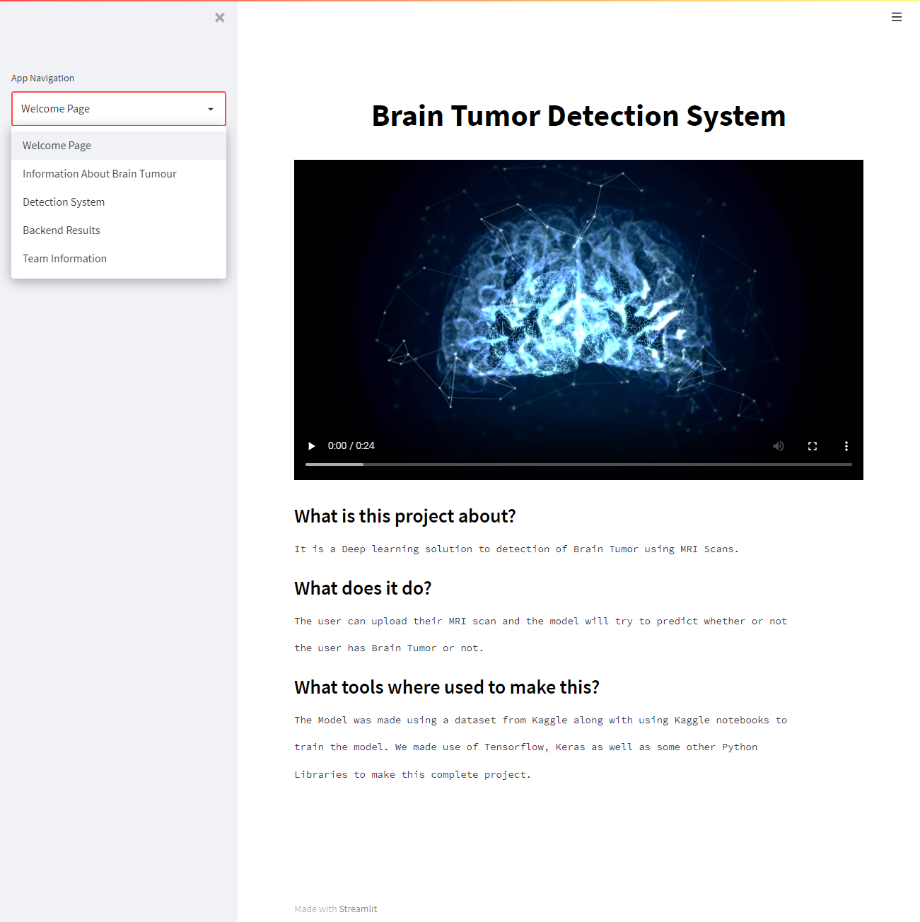
UI of Brain Tumor Detection System
Welcome Page

Slide 20
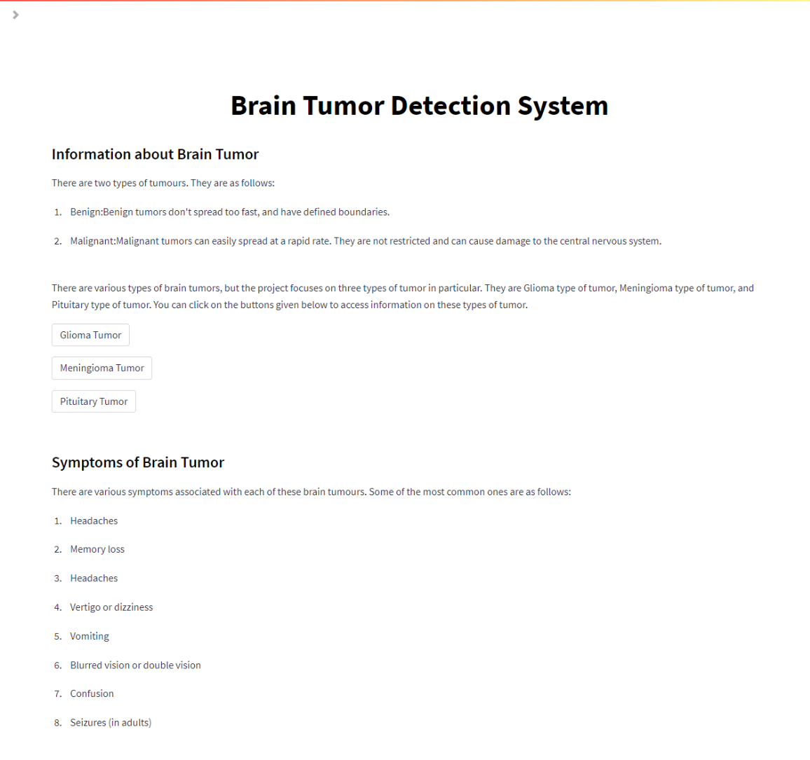
UI of Brain Tumor Detection System
Information Page

Slide 21
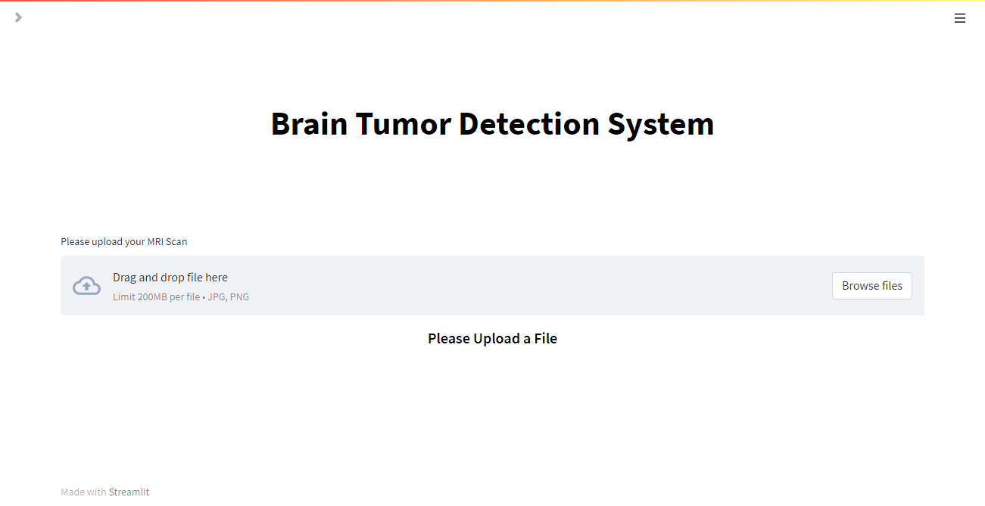
UI of Brain Tumor Detection System
Detection
Page

Slide 22
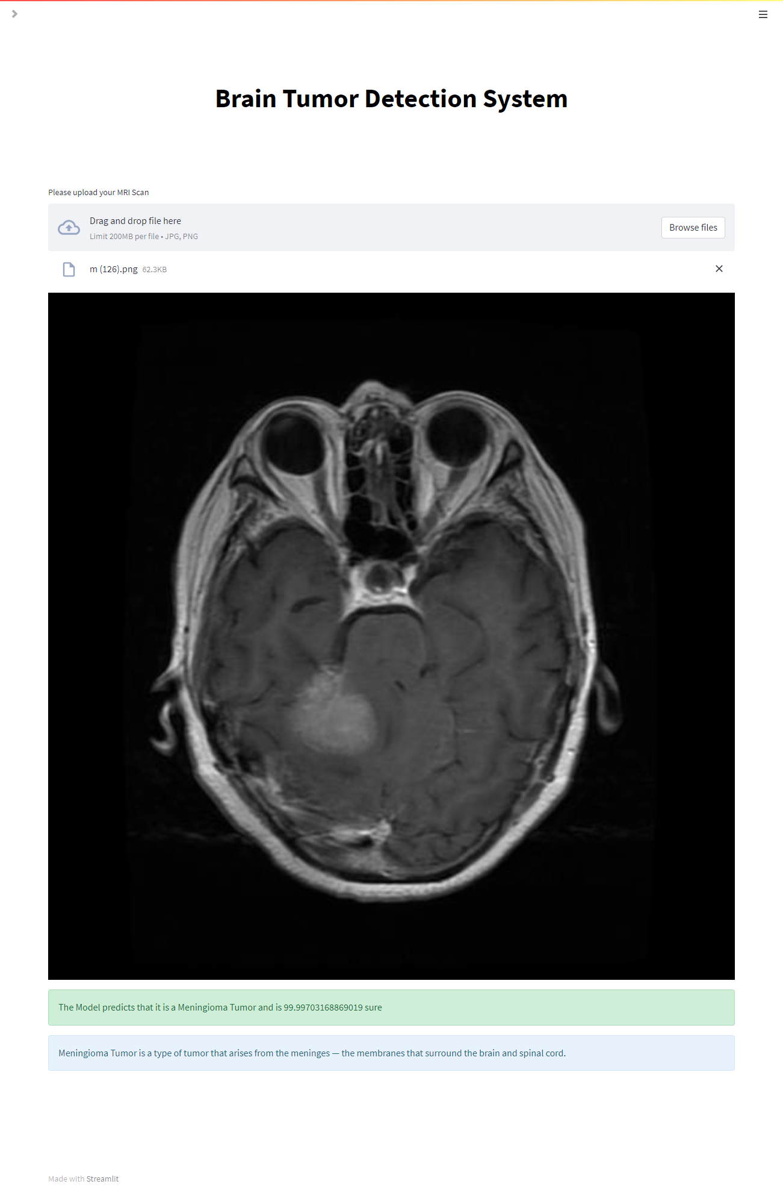
UI of Brain Tumor Detection System
Result -1 Page

Slide 23
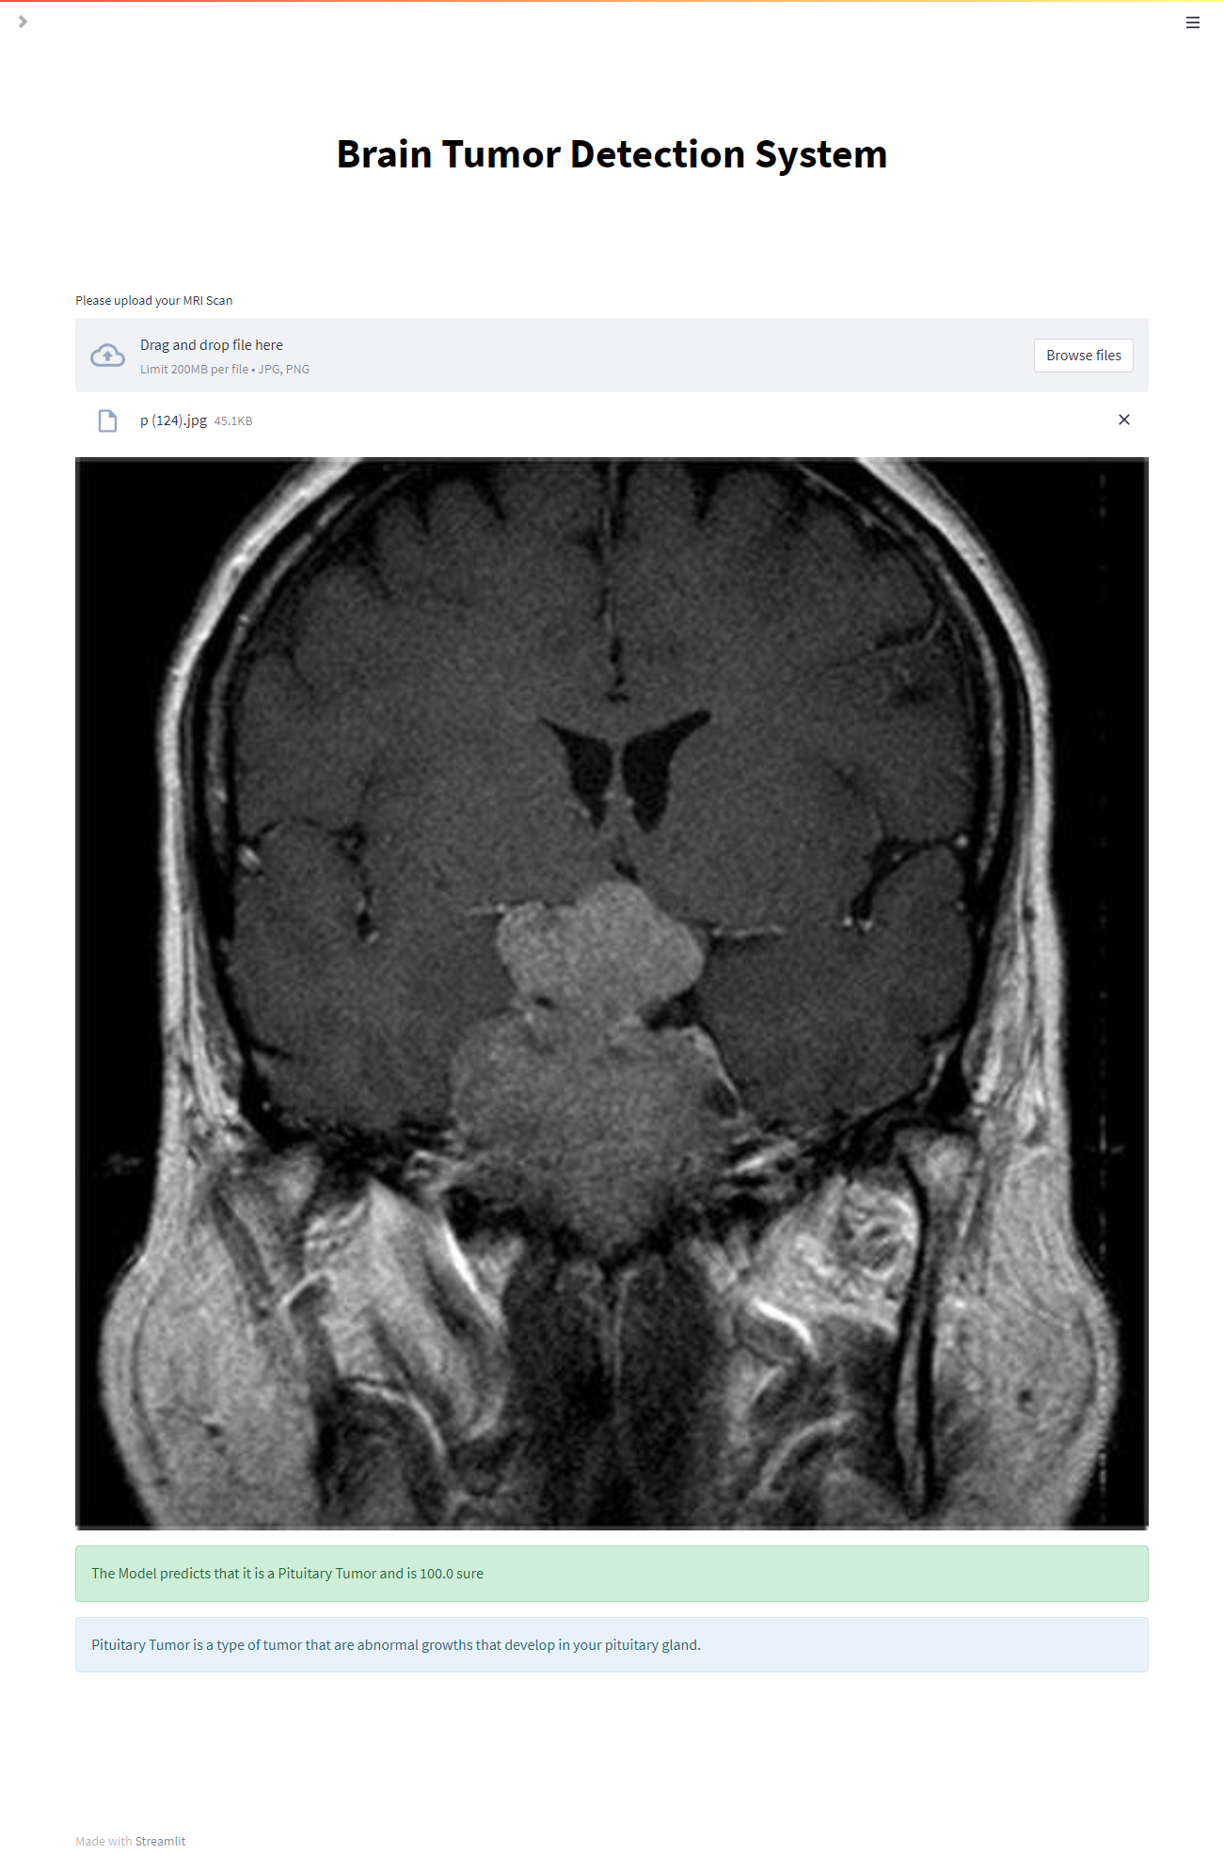
UI of Brain Tumor Detection System
Result - 2
Page

Slide 24
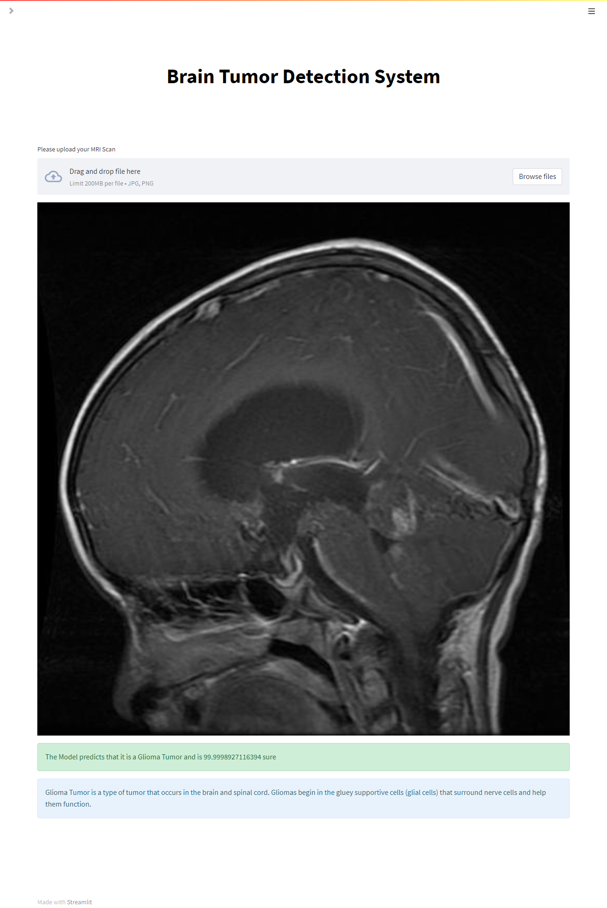
UI of Brain Tumor Detection System
Result - 3
Page

Slide 25
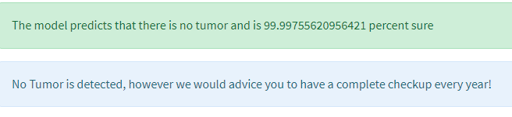
UI of Brain Tumor Detection System
Result - 4
Page

Slide 26
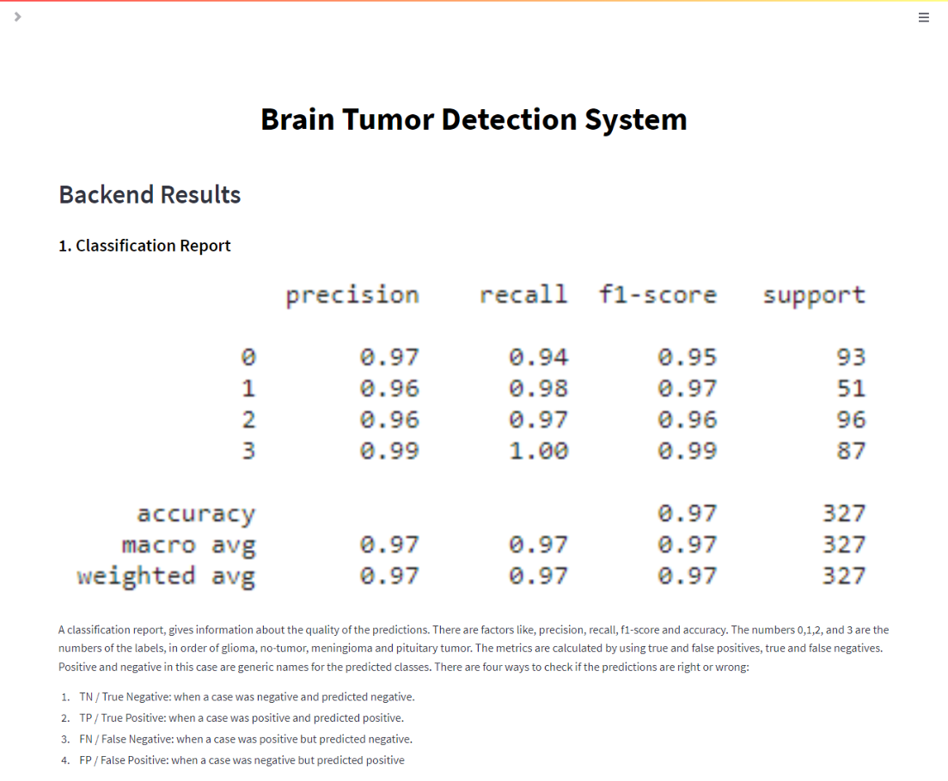
UI of Brain Tumor Detection System
Result Page

Slide 27
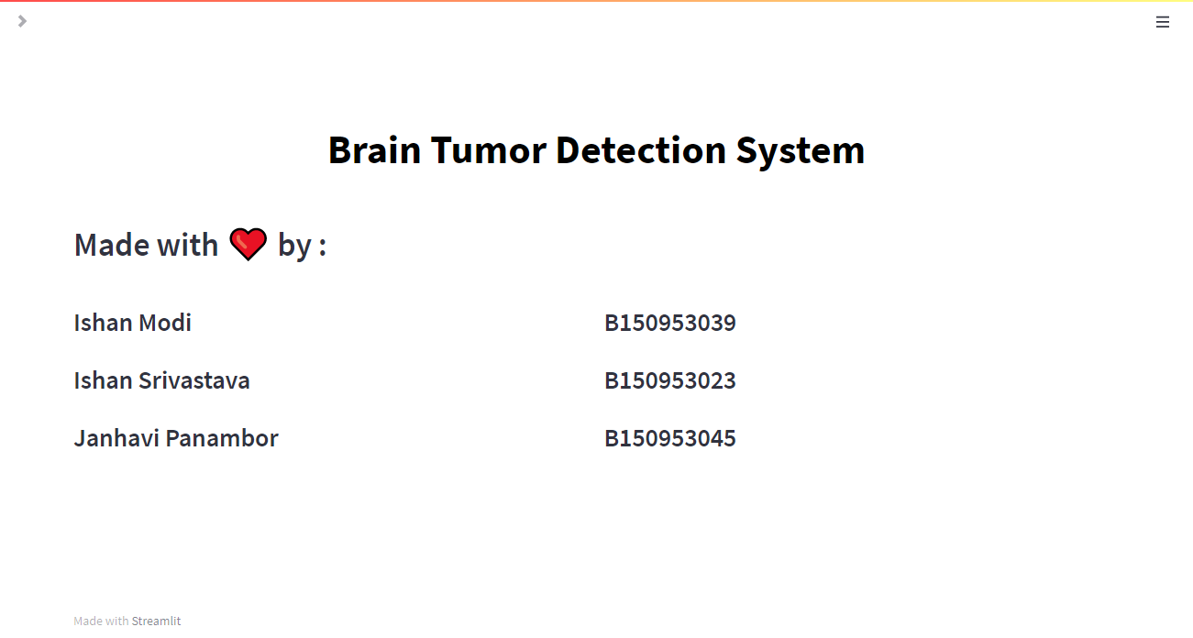
UI of Brain Tumor Detection System
Team Information page

Slide 28
Conclusion
Implementation of a Deep Learning Model which detects whether there is brain tumour present or not using image segmentation and analysis.
The model if it observes tumorous image is further able to classify the tumorous images into 3 categories : Meningioma, Pituitary and Glioma.
A total of 19 versions based on CNN Transfer Learning are developed with various parameters into consideration for detection of the tumour images which are being fed to the model.
Based on these results and further testing the model with the best accuracy gives an system accuracy of 97%.
As per the inference by the model the output will be displayed on the web application accordingly.

Slide 29
Future Scope
• The particular trained model can be further trained to detect tumor of initial stages.
• The system in its base form can be trained further to detect the tumour even more efficiently.
• The entire Web Application can be further developed to understand more types of human body scans such as X-ray, CT - Scans etc. So as to become a full fledged health assessment portal.
• Such web application could be installed at hospitals which will then connect patients and the hospital staff virtually.
• The system can be upgraded to detect more types of tumours such as ovarian, breast, skin, lung tumours etc.

Slide 30
References
Avigyan Sinha, Aneesh R P, Malavika Suresh, Nitha Mohan R, Abinaya D, Ashwin G Singerji “Brain Tumour Detection Using Deep Learning“ Seventh International conference on Bio Signals, Images, and Instrumentation (ICBSII), 2021
Nandita Goyal and Dr. Bharti Sharma“Image Processing Techniques for Brain Tumor Identification“ IOP Conf. Ser.: Mater. Sci. Eng. 1022 012011
Isselmou Abd El Kader, Guizhi Xu, Zhang Shuai, Sani Saminu, Imran Javaid, Isah Salim Ahmad and Souha Kamhi“Brain Tumor Detection and Classification on MR Images by a Deep Wavelet Auto-Encoder Model“ Diagnostics 2021
Saurabh Kumar, Iram Abid, Shubhi Garg, Anand Kumar Singh and Vivek Jain“Brain Tumor Detection using Image Processing“ International Journal of Information Sciences and Application (IJISA). ISSN 0974-2255, Vol.11, No.1, 2019, (Special Issue)

Slide 31
References
5. Ramin Ranjbarzadeh, Abbas Bagherian Kasgari, Saeid JafarzadehGhoushchi, ShokofehAnari, Maryam Naseri & Malika Bendechache“Brain tumor segmentation based on deep learning and an attention mechanism using MRI multi-modalities brain images“ Sci Rep. 2021 May 25;11(1):10930. doi: 10.1038/s41598-021-90428-8. PMID: 34035406; PMCID: PMC8149837.
6. P¨ar Salander, A Tommy Bergenheim, Katarina Hamberg, Roger Henriksson , “Pathways from symptoms to medical care: a descriptive study of symptom development and obstacles to early diagnosis in brain tumour patients“ Family Practice, Volume 16, Issue 2, April 1999, Pages 143–148
7. McKinney PA, “Brain tumours: incidence, survival, and aetiology,“ Journal of Neurology, Neurosurgery & Psychiatry 2004
8. Muhammad Waqas Nadeem, Mohammed A. Al Ghamdi, Muzammil Hussain, Muhammad Adnan Khan, Khalid Masood Khan, Sultan H. Almotiri and Suhail Ashfaq Butt, “Brain Tumor Analysis Empowered with Deep Learning: A Review, Taxonomy, and Future Challenges“ Brain Sci.2020

Slide 32
References
9. Logeswari, T.; Karnan, M.“An improved implementation of brain tumor detection using segmentation based on hierarchical self organizing map.“ Int. J. Comput. Theory Eng. 2010, 2, 591
10. Yang, G.; Raschke, F.; Barrick, T.R.; Howe, F.A.“Manifold Learning in MR spectroscopy using nonlinear dimensionality reduction and unsupervised clustering.“ Magn. Reson. Med. 2015, 74, 868–878.
11. Mansi Lathera, Dr. Parvinder Singh“Investigating Brain Tumor Segmentation and Detection Techniques “ International Conference on Computational Intelligence and Data Science (ICCIDS 2019)

Slide 33
Thank You

